Slide 1
Faculty Orientation: Overview of UHV-I in Student Induction Program
For Faculty and Student Buddies who are Volunteering in SIP

Slide 2
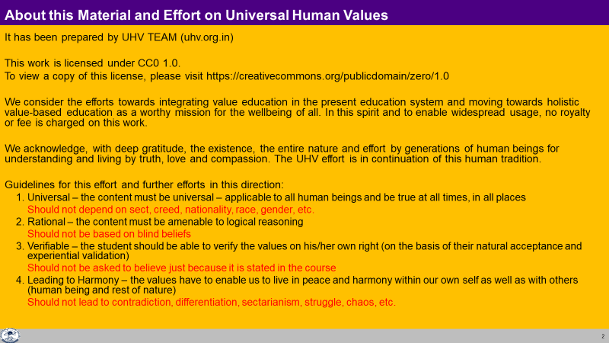

Slide 3
Agenda
What is the Student Induction Program
The UHV-I Module
How to Conduct UHV-I Resources

Slide 4
Student Induction Program – Context
New entrants go through years of strenuous preparation and get accustomed to it.
Often they lose the connection from social life and recreational activities
On the other hand, higher education, like engineering, demands a personality in all dimensions
The Student Induction Program is designed for a smooth transition
from school, preparation environment to higher education
Preparation
Bachelor’s Program
Induction
For Initial 21 Days
Student Activity Cell
For Remaining 4 Years

Slide 5
Goals of SIP
To become familiar with the ethos and culture of the new surroundings
To develop bonds with peers, seniors, faculty and staff
To provide an exposure to a holistic vision of life (based on larger national and human good; or the well-being of all)
Develop awareness, sensitivity and understanding of the
Self---family---Society---Nation---International---Entire Nature
To develop a healthy lifestyle and ethical professional discipline
To connect and appreciate the diversity of cultures
To overcome weaknesses in some essential professional skills to be ready for higher study (only for those who need, e.g., mathematics, languages/communication)

Slide 6
Universal Approach
All the SIP activities (modules) are based on generic and universal principles
Local, regional, national and international examples are taken so that students can relate them to their day to day life
For example, module 2 is about “physical health and related activities”. In this, we will be talking about “holistic human health” which is generic and universal. To exemplify this, we may take the example of Ayurved.
For example: We want to live with fulfilment as a society. This part is common, universal. To exemplify this, we may expose students to traditional Indian culture and philosophy as well as contemporary western culture
In this way:
It will help in connecting the basic principles through specific examples
It will help the student to see and appreciate various cultures, to see the commonality amongst them
It will help to evaluate any specific example, system or culture, with a view to fill the gaps, rather than to criticise or reject it. Further, we can also be mutually enriching for other cultures

Slide 7
Solution Centric Approach
The world today has become a mixture of various cultures
In India, we can see
Urban / City culture  Western culture
Liberal culture  Movie/Internet culture
Traditional rural Indian culture
and so many others
Today, the problem is that one culture tends to compare with other cultures and be opposed to them. This is because their basic assumptions and therefore thoughts are different. Even though there are commonalities at the core, the conflict is at the level of expression and details
With this situation, it is imperative to
Appreciate the different approaches and achievements
(to whatever extent a culture has realised the basic human values of truth, love and compassion at the core)
Be complimentary, help to fill the gaps, rather than to compare, criticise or reject

Slide 8

Inaugural Ceremony ~2 hours
M1: Universal Human Values I (UHV-I) 15-25
M2: Physical Health and Related Activities 35-50
M4: Visit to a Local Area 03-05
M5: Lectures by Eminent People 02-05
M7: Literature / Literary Activities 15-30
M8: Creative Practices 30-36
M9: Other co-curricular Activities 05-10
M3: Familiarization of Dept/ Branch and Innov 02-05
M6: Proficiency Modules 05-15
Grand Celebration 02-06
SIP Activities
Universal Human Values (UHV) Foundation
Indian Knowledge System (IKS)
including local, regional, national
international examples
focused on wellbeing of all
3 Weeks
Nature friendly and
human friendly skills and
their practice

Slide 9
UHV-I Module
UHV-I is intended to provide a glimpse of universal human values, and how going by them leads to living a fulfilling life – by looking at one’s aspirations holistically and resolving some of their present-day issues. It helps develop an interest in understanding harmony in completeness

Slide 10
UHV Module
In the UHV Module of SIP, the main points we want to highlight are:
Every student has the possibility to reach to their full potential as a human being
For this, we have to understand
Ourselves (our aspirations, concerns…), other people, other things around with which we interact…
Our relationships – with oneself, with other people, other things around us…
It is possible to understand – because
The need to understand is innate in every human being and
The potential to understand is intrinsic to human being
The essential things to understand are definite
We will use a process of self-exploration for this… we simply have to pay attention, and explore into the proposals… Let the time in this institution be a time of intense and joyous exploration!
UHV is an exploration into it, so that the student can discover their full human potential, develop a holistic plan for realising it and take some steps towards it

Slide 11
UHV Module
For this we will try to
Discover our aspirations and articulate our concerns
We can slowly realise that
We all have the same basic aspirations
We have to understand to fulfil our aspirations
We all have some concerns, some problems, These can be different for different students
To resolve any problem or concern also, we need to understand
The process to understand is simply to pay attention. We can easily do that. We can understand, realise our aspirations and resolve our concerns
E,g, Find out if it is true that “whatever you have paid attention to has revealed itself to you”. E.g. maths seemed so difficult, but now you know it… because you paid attention to it
In this UHV module, we will go over this process at four levels
Individual, family, society and nature

Slide 12
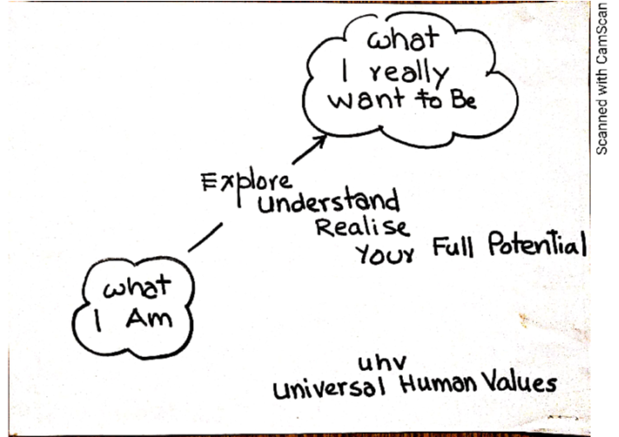
Aspirations (what you want to achieve)
Regarding self, as an individual
About family, friends, other people
Related to society, societal systems
In the natural environment
My Full Potential
Concerns (what you want to get rid of)
Regarding self, as an individual
About family, friends, other people
Related to society, societal systems
In the natural environment

Slide 13
Thus, the objectives of the UHV module (UHV-I) are:
To help the student to see the need for developing a holistic, humane world-vision
To sensitise the student about the scope of life – individual, family (inter-personal relationship), society and nature/existence
Strengthening self-reflection
To develop more confidence and commitment to understand, learn and act accordingly

Slide 14
How to Conduct UHV-I
An Overview
15 sessions of 1 to 1.5 hours each

Slide 15
General Guidelines
Conduct 15 sessions of 1.5 hours each in face-to-face mode in small groups of 20 students (only if not possible, use larger groups, shorter sessions or online mode)
Ensure that the guidelines (universal, rational, verifiable, leading to harmony)
Connect their real life, their aspirations and concerns with the basic reality (underlying harmony). This will help students to develop interest in understanding
Keep the discussion live, natural and interactive (not instructive, made-up, artificial…)
Propose, encourage exploration (not preach, try to convince, get students to “agree”…)
Have continuity from one session to another, overall (not independent unconnected…)
Prepare well
Note specific suggestions for refinement

Slide 16
Self
Self + Body
Other (human being, rest of Nature)
Understanding
Thinking
Doing
External Interaction

Slide 17
UHV-I Module
Session No. | Topic Title | Aspirations and Concerns | Basic Realities (underlying harmony)
1 | Welcome and Introductions | Getting to know each other | Basic need to relate
2 and 3 | Aspirations and Concerns | Individual academic, career… Expectations of family, peers, society, nation… Fixing one’s goals | Basic human aspirations and their fulfilment Need for a holistic, humane world-vision, Self-exploration
4 and 5 | Self-Management | Self-confidence, peer pressure, time management, anger, stress… Personality development, self-improvement… | Happiness Harmony in the human being Harmony in the Family
6 and 7 | Health | Health issues, healthy diet, healthy lifestyle Hostel life | Harmony of the Self and Body Mental and physical health

Slide 18
UHV-I Module…
8, 9, 10 and 11 | Relationships | Home sickness, gratitude towards parents, teachers and others Ragging and interaction Competition and cooperation Peer pressure | Harmony in the Family (feelings of trust, respect… gratitude, glory, love)
12 | Society | Participation in society | Harmony in the society
13 | Natural Environment | Participation in nature | Harmony in nature/existence
14 | Sum Up | Review role of education Need for a holistic, humane world-vision | Information about UHV-II course, mentor and buddy
15 | Self-evaluation and Closure | Sharing and feedback

Slide 19
UHV-I Session 1 Welcome and Introductions Let’s get to know each other!
Document prepared by AICTE NCC-IP Sub-committee for Mentor Manual and related Materials for UHV-I
Suggestions for improvement are welcome
All Rights Reserved

Slide 20
IND 1: Introductions
Goal: To develop a conducive teacher-taught environment
Activity: Introductions of faculty and students
Introduction of Faculty
Name:
Place to which I belong (root):
Educational background:
Role in the college / university:
Family background: parents, siblings, spouse, children:
Share an incident from your life or something you have understood which will connect to why you volunteered to facilitate the UHV session as a co-explorer, e.g.,
I will be your faculty co-explorer for this UHV orientation / I will be your mentor starting now till you leave the college (and maybe beyond that)
Introduction of Students
Please speak to the person sitting on your left and introduce him/her
Name:
Place from where s(he) belongs (root):
Department s(he) has joined:
One hobby or interest:
Family background: parents, siblings…
How s(he) relates to family and society:
Aspiration in life:
Expectation from education:
Please be specific (try not to use adjectives)

Slide 21
IND1: Home Assignments
1.1. Get to know as many of your batch mates as you can! You should be able to introduce at least 5 of them in detail
1.2. Make a list of your aspirations (चाहना), the expectations (अपेक्षा) of your family and friends and the hopes (आशा), you see, the nation has from you
1.3. Make a list of your achievements in your life
1.4 Make a list of your concerns (चिंता), fears (भय), confusions (भ्रम), questions (जिज्ञासा) etc.
To be written in your UHV-I Notebook
Aspirations (what you really want to be) | Achievements | Concerns

Slide 22
Did you draw attention to basic realities to be und. to address the aspiration or concern?
Session No. | Topic Title | Aspirations and Concerns | Basic Realities (underlying harmony)
1 | Welcome and Introductions | Getting to know each other | Basic need to relate
2 and 3 | Aspirations and Concerns | Individual academic, career… Expectations of family, peers, society, nation… Fixing one’s goals | Basic human aspirations and their fulfilment Need for a holistic, humane world-vision, Self-exploration
4 and 5 | Self-Management | Self-confidence, peer pressure, time management, anger, stress… Personality development, self-improvement… | Happiness Harmony in the human being Harmony in the Family
6 and 7 | Health | Health issues, healthy diet, healthy lifestyle Hostel life | Harmony of the Self and Body Mental and physical health

Slide 23
UHV I Session 2 Exploring our Aspirations and Concerns
Document prepared by AICTE NCC-IP Sub-committee for Mentor Manual and related Materials for UHV-I
Suggestions for improvement are welcome
All Rights Reserved

Slide 24
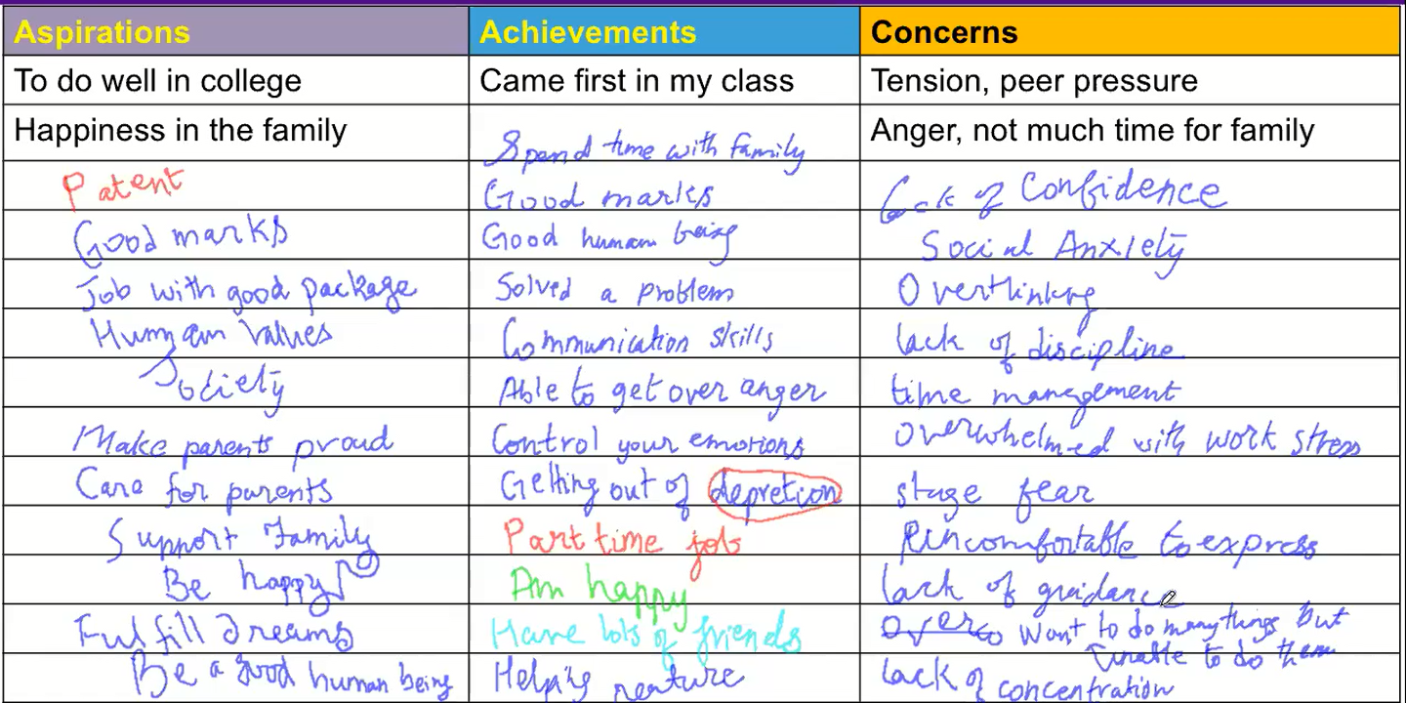
Part 1: Listen to participants’ exploration, home assignment… Q&A

Slide 25
Present effort
?
Expect to become something
??
Expect to get/do something
???
Expect to BE something
why
why
why
Studying | Engineer | Get Money Earn Name, Fame Do Research, Innovation Take care of your parents Make your family/nation proud Gain Expertise in area of your choice Earn your living well Live with Self Respect Get Power in society Earn Respect Get Satisfaction And so on…
Doing internship | Doctor
Practicing | Farmer
Attending coaching | IAS Officer
Doing articleship | Lawyer
Doing MBA | Businessman
Researching | Scientist
Painting | Artist
Happy and prosperous
These may be steps toward the basic aspiration
Basic Aspiration
Effort for a fulfilling Life

Slide 26
Present effort
(1)
?
Expect to become something
(2)
??
Expect to get/do something
(3)
???
Expect to be happy and prosperous
(4)
How would you like to plan your life?
1-2-3-4: Plan the steps without being clear of your basic aspiration?
or
4-3-2-1: Develop clarity of your basic aspiration (happiness and prosperity) and then work out the steps?
Check how you are planning now
These are steps toward our basic aspiration
It is a path to fulfilling our basic aspiration
Basic Aspiration
Fulfilling Life

Slide 27
IND 2: Key Points
Everyone has some aspirations, some concerns. To identify the basic aspiration, ask why multiple times
The basic aspiration (of every human being) is continuity of happiness and prosperity
The goals to be something, to do something, to get something may be steps, but not the basic aspiration
There may be several steps leading to the fulfilment of the basic aspiration, so if one path is not available, another path can be taken
Planning the steps can be done more effectively with clarity of the basic aspiration (end goal, where you want to reach and stay in continuity), rather than being chosen on some other basis
Students can be facilitated in exploring

Slide 28
Did you draw attention to basic realities to be und. to address the aspiration or concern?
Session No. | Topic Title | Aspirations and Concerns | Basic Realities (underlying harmony)
1 | Welcome and Introductions | Getting to know each other | Basic need to relate
2 and 3 | Aspirations and Concerns | Individual academic, career… Expectations of family, peers, society, nation… Fixing one’s goals | Basic human aspirations and their fulfilment Need for a holistic, humane world-vision, Self-exploration
4 and 5 | Self-Management | Self-confidence, peer pressure, time management, anger, stress… Personality development, self-improvement… | Happiness Harmony in the human being Harmony in the Family
6 and 7 | Health | Health issues, healthy diet, healthy lifestyle Hostel life | Harmony of the Self and Body Mental and physical health

Slide 29
UHV-I Session 3 Basic Human Aspirations and their Fulfilment
Document prepared by AICTE NCC-IP Sub-committee for Mentor Manual and related Materials for UHV-I
Suggestions for improvement are welcome
All Rights Reserved

Slide 30
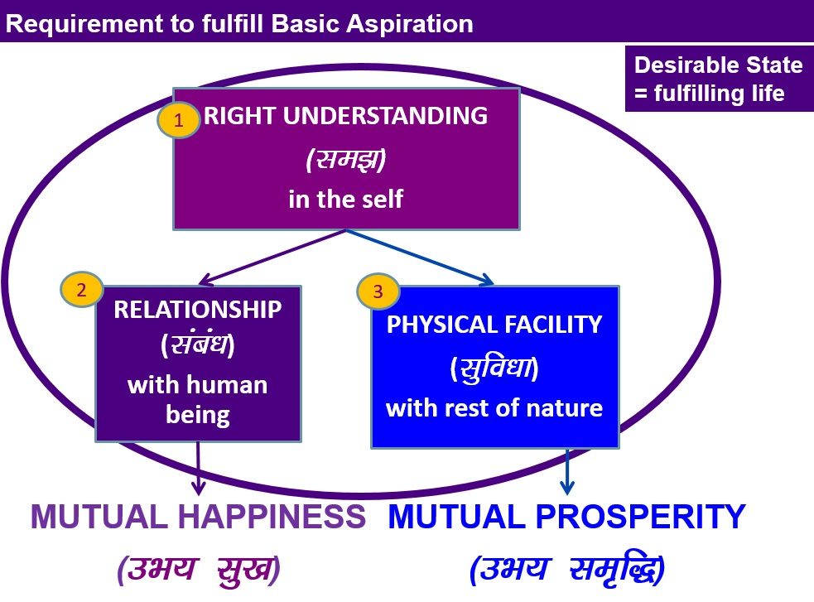
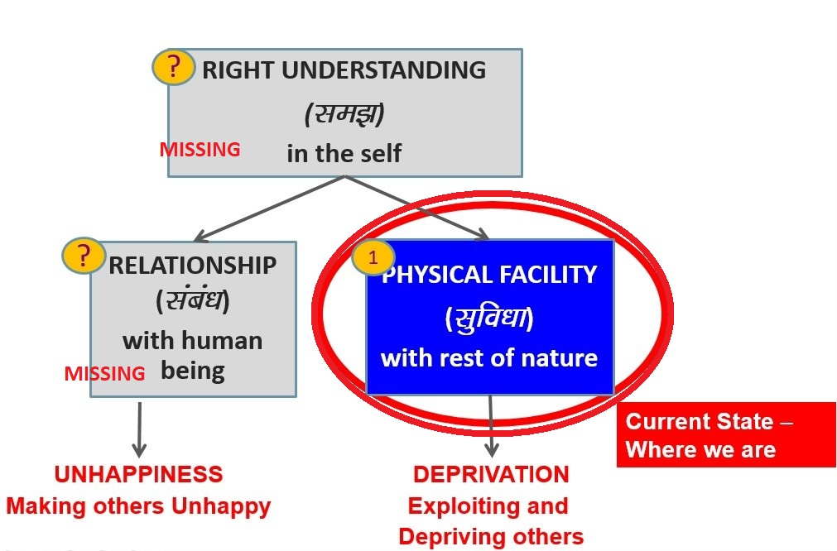

Transformation (ladze.k) = Holistic Development (fodkl)
Transformation& Progress
laØe.k&fodkl
Where do you want to be – on the left or on the right?
Is this transformation desirable for you?
Do you need to make effort for this transformation?
Do you need a holistic, humane world-vision to make this effort?
Should education help you to make this effort?

Slide 31
IND 3: Key Points
Right Understanding, Relationship and Physical Facility are required for the fulfilment of aspirations or resolution of concerns
Holistic Development is the Transformation from Current State to Desired State
While presenting, cover the content mentioned, rather than open up new content. E.g., in this presentation, the difference between animal conscious and human consciousness is not covered – it is covered in the Introductory UHV FDP for faculty, but not in UHV-I for students – it is covered in UHV-II for students
While responding to questions, stay with the content covered, rather than open up new content that may be covered later. Our role is to encourage and facilitate the student to explore and find the answers within, not to provide ready-made answers

Slide 32
Home Assignment 3.1
Take your list of aspirations + concerns (from session 1 home assignment).
Find out what is needed to fulfill your aspirations + address your concerns
– right understanding (clarity)
– relationship (right feeling)
– physical facility (money, some real physical facility like food, clothes, shelter, mobile…)
e.g., Aspiration/Concern right und relationship physical facility
Money ? ?  (salary…)
Name, fame, attention   
good food ? ?  (food)
latest bike ? ?  (bike)
peace of mind   (family and friends)
good health   (with body) 
Also find out approximately how much time and effort you put in every day in these 3 areas

Slide 33
Through exploration, students are expected to see the following
For the fulfilment of any aspiration or for addressing any concern, right understanding and relationship are definitely required. Physical facility may or may not be required
In general, our effort is mostly for physical facility (maybe because we have assumed that it is the main thing required for a fulfilling life),
so more effort is required on developing right understanding
Example
Aspiration
/Concern 1 right understanding 2 relationship (right feeling) 3 physical facility
Money    (salary…)
Good friends    (food…)
Peace of mind   (within!) may not be required!
All the three are required
The base is right understanding
On that basis the feeling of relationship (within)
And with that, physical facility

Slide 34
Did you draw attention to basic realities to be und. to address the aspiration or concern?
Session No. | Topic Title | Aspirations and Concerns | Basic Realities (underlying harmony)
1 | Welcome and Introductions | Getting to know each other | Basic need to relate
2 and 3 | Aspirations and Concerns | Individual academic, career… Expectations of family, peers, society, nation… Fixing one’s goals | Basic human aspirations and their fulfilment Need for a holistic, humane world-vision, Self-exploration
4 and 5 | Self-Management | Self-confidence, peer pressure, time management, anger, stress… Personality development, self-improvement… | Happiness Harmony in the human being Harmony in the Family
6 and 7 | Health | Health issues, healthy diet, healthy lifestyle Hostel life | Harmony of the Self and Body Mental and physical health

Slide 35
UHV-I Session 4 Aspirations and Concerns at the Individual level
Document prepared by AICTE NCC-IP Sub-committee for Mentor Manual and related Materials for UHV-I
Suggestions for improvement are welcome
All Rights Reserved

Slide 36
From the list of Aspirations and Concerns, draw out those at the Individual Level
To be happy
To be healthy
To be prosperous
Knowledge – quest for knowledge
Ability to decide properly on my own, independently
Clarity in thoughts
Self confidence
…
Coming out of stress
Managing pressure of academics
Time management
Time lost due to illness
Entertainment
Domination of one gender by the other
Pressure of placement
Overcoming –ve thinking
Attending classes
Peer pressure
Temptations
Anger
Depression
Suicidal thoughts

Slide 37
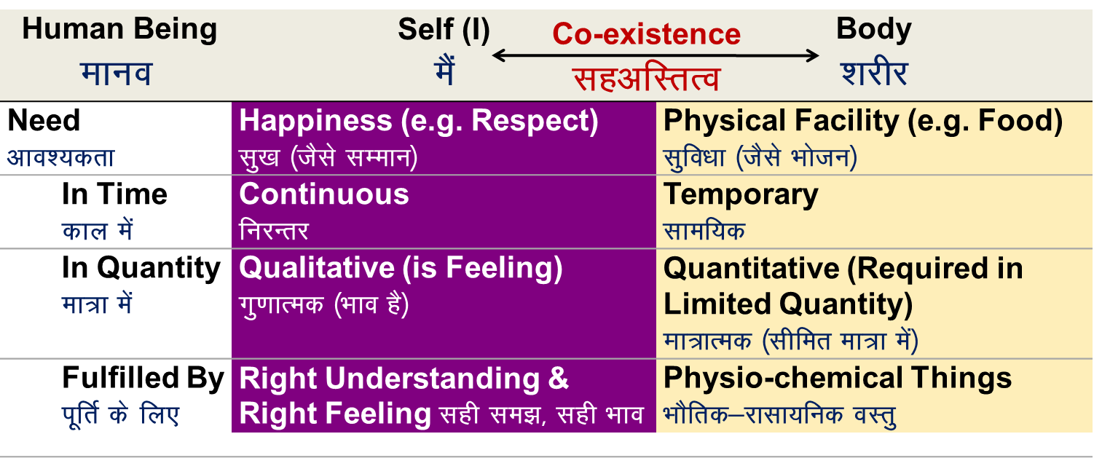
Key Points
Recall: our aspirations can be fulfilled and concerns can be resolved by
Right understanding (सही समझ) in the self
Living with fulfilment in relationship (संबंध) with human beings and
Ensuring more than required physical facility (सुविधा) with rest of nature
The root cause of concerns, problems can be traced to lack of right understanding
In this session, a basic proposal
about Human Being is shared
Explore if understanding human being makes any difference. Two examples are shared:
Health of body
The other is like me

Slide 38
Exploration 1
While selecting and eating food, what is desirable?
Selecting nutritious and tasty food Body is nourished + Self is happy
Selecting nutritious, but not tasty food Body is nourished + Self is unhappy
Selecting not nutritious, but tasty (Junk food) Body is not nourished + Self is happy
Selecting not nutritious and not tasty food Body is not nourished + Self is unhappy
Who is selecting what to eat, how much to eat, when to eat…? Self or Body?
Find out what is the difference it may make by
understanding human being as the co-existence of self and body or
assuming that human being is just a body (or something else)

Slide 39
Did you draw attention to basic realities to be und. to address the aspiration or concern?
Session No. | Topic Title | Aspirations and Concerns | Basic Realities (underlying harmony)
1 | Welcome and Introductions | Getting to know each other | Basic need to relate
2 and 3 | Aspirations and Concerns | Individual academic, career… Expectations of family, peers, society, nation… Fixing one’s goals | Basic human aspirations and their fulfilment Need for a holistic, humane world-vision, Self-exploration
4 and 5 | Self-Management | Self-confidence, peer pressure, time management, anger, stress… Personality development, self-improvement… | Happiness Harmony in the human being Harmony in the Family
6 and 7 | Health | Health issues, healthy diet, healthy lifestyle Hostel life | Harmony of the Self and Body Mental and physical health

Slide 40
UHV-I Session 5 Resolution of Concerns Peer pressure, Reaction…
Document prepared by AICTE NCC-IP Sub-committee for Mentor Manual and related Materials for UHV-I
Suggestions for improvement are welcome
All Rights Reserved

Slide 41
Concern
Analysis
We want to be accepted by others
We think that we will be accepted when we are like them or better than them – in how we look, how we dress, how we talk, what we eat, what we drink, etc.
So, there is a pressure to be like them or better – in appearance, clothes, language and expression (e.g. English), etc.
This is part of the peer pressure
If we assume that happiness may be ensured by favourable feeling from others, we try to get these feelings from them by way of:
Being ahead of others - (in terms of appearance, clothes, language & expression- English, money etc)
Seeking alikeness - belongingness with a specific group (because others are doing it/ having it, so should I)
These two become the major sources of peer pressure
Even the other may be in the same state i.e., wanting to be accepted by you!

Slide 42
We try to address Peer Pressure by
There is a Third Option
1. Copying (नक़ल) – we give in to peer pressure
2. Arbitrariness (मनमानी) – we rebel (विद्रोह)
3. Right Understanding (सही समझ)
Verifying things on your own right:
On the basis of your natural acceptance and
On the basis of validating by living accordingly (experiential validation)
- (understanding happiness)
- (understanding human being) The other is like me
(understanding relationship, trust) We feel happy when we relate to each other, be complimentary to each other, help each other to develop rather than oppose each other

Slide 43
What is Naturally Acceptable to You? What is the Solution?
Copying – adopting Arbitrariness Right Understanding
Living Living Living
on the basis of others on the basis of on the basis of
(some do’s & don’ts) one’s own natural acceptance
likes-dislikes
Indefinite Indefinite Definite
conduct conduct conduct
Sometimes “happy” Sometimes “happy” Always happy
Sometimes “sad” Sometimes “sad” (निरंतर सुख)
Decided by other Rebel Self-organised
“Peer Pressure” “Reaction” Self-confident
(परतंत्रता) (परतंत्रता) (स्वतंत्रता)

Slide 44
Did you draw attention to basic realities to be und. to address the aspiration or concern?
Session No. | Topic Title | Aspirations and Concerns | Basic Realities (underlying harmony)
1 | Welcome and Introductions | Getting to know each other | Basic need to relate
2 and 3 | Aspirations and Concerns | Individual academic, career… Expectations of family, peers, society, nation… Fixing one’s goals | Basic human aspirations and their fulfilment Need for a holistic, humane world-vision, Self-exploration
4 and 5 | Self-Management | Self-confidence, peer pressure, time management, anger, stress… Personality development, self-improvement… | Happiness Harmony in the human being Harmony in the Family
6 and 7 | Health | Health issues, healthy diet, healthy lifestyle Hostel life | Harmony of the Self and Body Mental and physical health

Slide 45
UHV-I Session 6 Understanding Health (Part 1 of 2)
Document prepared by AICTE NCC-IP Sub-committee for Mentor Manual and related Materials for UHV-I
Suggestions for improvement are welcome
All Rights Reserved

Slide 46
Aspirations and Concerns at the Individual Level
To be happy
To be healthy
Knowledge – quest for knowledge
Ability to decide properly on my own, independently
Purification of the mind
Controlling the mind
Self confidence
Coming out of stress
Managing pressure of academics
Time management
Loss of time due to illness
Entertainment
Domination of one gender by the other
Pressure of placement
Overcoming –ve thinking
Attending classes
Peer pressure
Temptations
Anger
Depression
Suicidal thoughts

Slide 47
Aspirations Concerns
To be healthy
Want to eat tasty but healthy food
Want a healthy, peaceful environment
Infections (environment)
Non-communicable disorders like obesity
Tension, depression
Inefficient use of time
Time loss due to illnesses
Let us explore how understanding human being can help us in:
realising our aspirations and also resolving the issues holistically

Slide 48
Human Being Ekkuo | Self (I) eSa | Body “kjhj
Need vko';drk | Happiness (e.g. Respect) lq[k ¼tSls lEeku½ | Physical Facility (e.g. Food) lqfo/kk ¼tSls Hkkstu½
Fulfilled By iwfrZ ds fy, | Right Understanding & Right Feeling lgh le>] lgh Hkko | Physio-chemical Things HkkSfrd&jklk;fud oLrq
 | Feeling of Self-regulation(संयम) | Health (स्वास्थ्य)
 | Feeling of responsibility toward the body – for Nurturing, Protection and Right Utilization of the Body | The Body acts according to the Self Parts of the body are in harmony (in order)
Co-existence
lgvfLrRo
Notes:
Who is the observer? Self or body?
Can you see that you are always active “imagination” is always going on

Slide 49
Program
(A) For Staying Healthy
1 Intake and Daily Routine (Lifestyle)
2 Labour and Exercise
3 Postures for regulating internal & external body organs
and Regulated Breathing
4 Medicine and Treatment
(B) For bringing body back to harmony from temporary disharmony
(C) Dependence on drug / machine to perform a body function
1a. Intake includes air, water, sunlight, food (food is nutritious, digestible & tasty and waste is excretable), all intake through our senses (sound, sight, smell etc)
1b. Rising time, sleeping time, eating time…
2a. Outcome of labour is production of physical facility
2b. No physical facility is produced by exercise

Slide 50

Priority
1
(A) For Staying Healthy
1a
1 Intake and Daily Routine (Lifestyle)
2 Labour and Exercise
3 Postures for regulating internal & external body organs and Regulated Breathing
4 Medicine and Treatment
1b
2
(B) For bringing body back to harmony from temporary disharmony
3
(C) Dependence on drug / machine to perform a body function

Slide 51
Sum Up
Human Being is co-existence of Self and Body, Body is an instrument of the Self
Physical Facility is required, in a limited quantity, for Nurturing, Protection & Right Utilisation of the Body
The Self and the Body are in Harmony when there is a feeling of Self-regulation in the Self and Health in the Body
Self-regulation = Feeling of responsibility toward the body – for Nurturing, Protection and Right Utilization of the Body
Health = The body acts according to Self and parts of the body are in harmony (in order)

Slide 52
Did you draw attention to basic realities to be und. to address the aspiration or concern?
Session No. | Topic Title | Aspirations and Concerns | Basic Realities (underlying harmony)
1 | Welcome and Introductions | Getting to know each other | Basic need to relate
2 and 3 | Aspirations and Concerns | Individual academic, career… Expectations of family, peers, society, nation… Fixing one’s goals | Basic human aspirations and their fulfilment Need for a holistic, humane world-vision, Self-exploration
4 and 5 | Self-Management | Self-confidence, peer pressure, time management, anger, stress… Personality development, self-improvement… | Happiness Harmony in the human being Harmony in the Family
6 and 7 | Health | Health issues, healthy diet, healthy lifestyle Hostel life | Harmony of the Self and Body Mental and physical health

Slide 53
UHV-I Session 7 Program for Health (Part 2 of 2)
Document prepared by AICTE NCC-IP Sub-committee for Mentor Manual and related Materials for UHV-I
Suggestions for improvement are welcome
All Rights Reserved

Slide 54
Looking at Health holistically
Health of the Human being = Health of the Self → Health of the Body
The family has an impact on the health of the individual
A family that keeps “an early to rise and early to bed” schedule is healthier
A family with internal strife, fighting etc. may be more prone to illness
Like that, in the society and nature
Holistic
Health Health of the Self Health of the Body
Health of the Environment = Health of Family, Society, Nature
1
2
3

Slide 55
Discussion: Health of the Family, Friends Circle…
Food habits
Daily routine
Collective labour
Collective exercise…
Home remedies…

Slide 56
Discussion: Health of the Society (Institution…)
Hostel – Timings for healthy lifestyle (sleeping time, waking time…)
Mess – Options for tasty and healthy food, giloy kadah…
Canteen – Tasty and healthy options
Juice stall – fresh fruit and vegetable juice
…

Slide 57
Discussion: Health of the Natural Environment
Clean and fresh air
Water
Free of viruses
…
Natural Farming Club – In campus production by way of labour

Slide 58
Key Points
Holistic Health: Health of the Self, Body and Environment
Programs of Self-regulation with a holistic, humane world-vision

Slide 59
Did you draw attention to basic realities to be und. to address the aspiration or concern?
Session No. | Topic Title | Aspirations and Concerns | Basic Realities (underlying harmony)
1 | Welcome and Introductions | Getting to know each other | Basic need to relate
2 and 3 | Aspirations and Concerns | Individual academic, career… Expectations of family, peers, society, nation… Fixing one’s goals | Basic human aspirations and their fulfilment Need for a holistic, humane world-vision, Self-exploration
4 and 5 | Self-Management | Self-confidence, peer pressure, time management, anger, stress… Personality development, self-improvement… | Happiness Harmony in the human being Harmony in the Family
6 and 7 | Health | Health issues, healthy diet, healthy lifestyle Hostel life | Harmony of the Self and Body Mental and physical health

Slide 60
UHV-I Session 8a The Foundation of Relationship – Trust (Concerns: Anger, Mistrust, Fear…)
Document prepared by AICTE NCC-IP Sub-committee for Mentor Manual and related Materials for UHV-I
Suggestions for improvement are welcome
All Rights Reserved

Slide 61
Relationship
These are the four aspects to understand about relationship:
Relationship is – Relationship is already there (whether we recognise it or not) – Relationship is between one self (I₁) and another self (I₂)
– The Body is used for expression
2. There are feelings in relationship – in one self (I₁) for the other self (I₂)
3. These feelings can be recognized
– they are definite
4. Their fulfilment leads to mutual happiness

Slide 62
Analysis of Current State
Today we are unhappy because we have not understood these feelings and we assume that they are not in us
We only expect the other to express these feelings to us. If the other expresses these feelings to us, we feel happy. If the other does not express these feelings to us, we feel unhappy
In this situation, to get respect, we try many things
e.g. we relate respect(feeling) with physical facility
e.g. we copy appearance, language, lifestyle, etc. opted by others
Today, people are not able to express feeling of respect to others (because they don’t have it), but they are trying hard to get it from others
It is like everyone is begging for respect and everybody’s bowl is empty

Slide 63
The Way Forward
The most fundamental thing is to understand these feelings.
In this way, understanding the feeling, ensuring the feeling, expressing the feeling and the right evaluation of the feeling leads to mutual happiness
We will try to understand the feeling of TRUST first (as foundational feeling)

Slide 64
Did you draw attention to basic realities to be und. to address the aspiration or concern?
8, 9, 10 and 11 | Relationships | Home sickness, gratitude towards parents, teachers and others Ragging and interaction Competition and cooperation Peer pressure | Harmony in the Family (feelings of trust, respect… gratitude, glory, love)
12 | Society | Participation in society | Harmony in the society
13 | Natural Environment | Participation in nature | Harmony in nature/existence
14 | Sum Up | Review role of education Need for a holistic, humane world-vision | Information about UHV-II course, mentor and buddy
15 | Self-evaluation and Closure | Sharing and feedback

Slide 65
Trust (FOUNDATIONAL VALUE)

Slide 66
Trust (fo”okl)
Trust = to be assured (vk”oLr gksuk)
= to have the clarity that the other wants to make me
happy & prosperous
= nwljk esjs lq[k] le`f) ds vFkZ esa gS] ,slk Li’V gksuk

Slide 67
Evaluating Trust – Between 2 Individuals
About your Natural Acceptance
1a. I want to make myself happy always
2a. I want to make the other happy always
3a. The other wants to make herself/himself happy always
4a. The other wants to make me happy always
About your Ability
1b. I am able to make myself always happy
2b. I am able to make the other always happy
3b. The other is able to make herself/himself always happy
4b. The other is able to make me always happy
√
?
√
?
√
?
?
??
Intention – Natural Acceptance
What is Naturally Acceptable to You
Competence
What You Are (∑ D, T, E)

Slide 68
Trust: To have the clarity that the other intends to make me happy
About our Natural Acceptance
1a. I want to make myself always happy always
2a. I want to make the other always happy always
3a. The other wants to make herself/himself always happy al
4a. The other wants to make me always happy always
About our Ability
1b. I am able to make myself always happy
2b. I am able to make the other always happy
3b. The other is able to make herself/himself always happy
4b. The other is able to make me always happy
√
?
√
?
√
?
√
??
Intention – Natural Acceptance
What is Naturally Acceptable to You
Competence
What You are (Imagination)

Slide 69
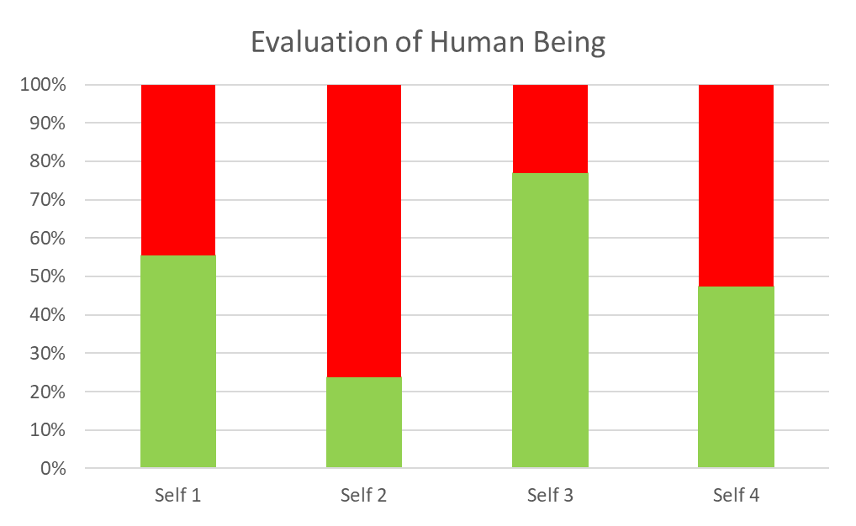
Trust
Intention (natural acceptance) is
same for all
Lack of Competence
Competence of various people may be quite different
Competence
Me (Self₁) Self_{i} Self_{j} Self_{k}
Take-away:
Trust on Intention (Natural Acceptance)
I am able to see that
the other has a natural acceptance (intention) to make me happy
s(he) may or may not have the competence to do so

Slide 70
Resolution of Concerns
Doubt on Intention leads to issues like Mistrust on the other, Anger, Fear in relationships, etc.
With Trust on Intention, one is able to get rid of the root cause of such issues.
In UHV II, the resolution of such issues will be discussed further.

Slide 71
Anger – Reason Anger – Solution
Anger arises, when we are not able to differentiate between the intention and competence of the other. Based on lack of competence of the other, we doubt over their intention
Once, we have a doubt on the intention of the other, then instead of relating to the other, we feel in opposition to the other
Thus, any small unfavourable incidence may lead to irritation or even anger
If I understand the human being correctly, then am able to see-
“The other is a human being like me (co-existence of self and body)”
The other self has the intention, i.e. natural acceptance (to be happy and make other happy) just like me
The other may be lacking in competence to fulfil their intention, just like I am lacking in competence
With Trust on Intention, we feel related to the other. Then there is no feeling of Anger

Slide 72
Anger – Reason Anger – Solution
When our desire does not get fulfilled and we perceive that it is due to the other, then we get irritated or angry
If I can see that the other has the right intention, but lacks competence, then instead of getting angry, I re-examine my desire/expectation and action:
Is my expectation right or not?
Is the program to fulfill the desire correct or not?
Have I developed the necessary competence in myself ?
What effort have I made to help the other in improving his/her competence?

Slide 73
Sum Up
Trust is to have the clarity that the other wants to make me happy & prosperous
If I have trust on intention, I accept the other (I am assured of the other) and we are able to make effort for mutual development
I make a program with the other based on right evaluation of our mutual competence
In case the other is lacking in competence
I make effort to assure the other
I make effort to improve his competence once he is assured in relationship (and not before that)
If I lack competence, I become ready to take help from the other to improve my competence
If I have doubt on intention
I evaluate myself on the basis of my intention and others on the basis of their competence
I have a feeling of opposition with the other which shows up as irritation or anger (and it further leads to fighting, struggle and war)

Slide 74
Did you draw attention to basic realities to be und. to address the aspiration or concern?
8, 9, 10 and 11 | Relationships | Home sickness, gratitude towards parents, teachers and others Ragging and interaction Competition and cooperation Peer pressure | Harmony in the Family (feelings of trust, respect… gratitude, glory, love)
12 | Society | Participation in society | Harmony in the society
13 | Natural Environment | Participation in nature | Harmony in nature/existence
14 | Sum Up | Review role of education Need for a holistic, humane world-vision | Information about UHV-II course, mentor and buddy
15 | Self-evaluation and Closure | Sharing and feedback

Slide 75
UHV-I Session 8b Video Discussion Right Here Right Now (Reaction and Response)
Document prepared by AICTE NCC-IP Sub-committee for Mentor Manual and related Materials for UHV-I
Suggestions for improvement are welcome
All Rights Reserved

Slide 76
Right Here Right Now
Watch the video Right Here Right Now
A short film about human behavior and its propagation. It is directed by Anand Gandhi
Source:
Part 1: https://www.youtube.com/watch?v=OVAokeqQuFM
Part 2: https://www.youtube.com/watch?v=gIYJePEnvUY
We will discuss your observations:
Interactions with each other – reaction or response
2. Are the actions indicating right understanding, trust?

Slide 77
Response Reaction
You decide your feeling on your own right | You decide your feeling based on the behavior of the other
It is based on right understanding You always have the right feeling It is definite and unconditional The behavior of the other is only an indicator of the state of the other With that input you decide your behavior to ensure mutual happiness | It depends on whether you like or dislike the (taste of the) behavior of the other If the other behaves properly, you have a right feeling and may behave properly If the other misbehaves, you have a wrong feeling and you may also misbehave
You decide your own behaviour You are self-organised | Your “remote control” is with the others You are enslaved
Your conduct is definite | Your conduct is indefinite

Slide 78
Self Reflection
In your own interactions, find out
the % time you are responding
the % time you are reacting
What is the effort required to progress from reaction to response?
To develop the right understanding (at least about relationship)…
(this will be discussed in detail in the UHV-II course)
To be aware of your imagination, develop the right feeling within
To “repair” the damage from past reactions

Slide 79
How are people deciding?
Decisions are motivated by preconditioning
Decisions are motivated by sensation
Decisions are on the basis of self verification based on their natural acceptance
Eg.
How did the grandmother decide that it is OK for Shruti to marry the doctor?
Why did the boy say “I love you” to Chahat
Why did the doctor decide to pick up the accident victim, even though he was getting late to meet Shruti?

Slide 80
How do we decide?
Are our decisions motivated by preconditioning? What %?
Are our decisions motivated by sensation? What %
What % of our decisions are on the basis of self verification, based on our natural acceptance?
What is the share of
preconditioning, B. sensation and
C. self-verification in your decisions?
e.g. A 50, B30, C20

Slide 81
Sum Up
Response is naturally acceptable, Reaction is not acceptable naturally.
Reaction could be Positive or Negative, but it is not based on right understanding, right feeling.

Slide 82
UHV-I Session 9 Respect – Right Evaluation of Intention and Competence (Concerns: Lack of Self-confidence, Ego, Depression, Peer Pressure, Differentiation,…)
Document prepared by AICTE NCC-IP Sub-committee for Mentor Manual and related Materials for UHV-I
Suggestions for improvement are welcome
All Rights Reserved

Slide 83
Respect (lEeku)
Respect = Right Evaluation
lEeku ¾ le~ $ eku
lE;d~ ekiuk
Bhd Bhd vkadyu djuk

Slide 84
Common Mistakes
Over evaluation – to evaluate for more than what it is
vf/kewY;u vf/kd vkaadyu djuk
Under evaluation – to evaluate for less than what it is
voewY;u de vkaadyu djuk
Otherwise evaluation – to evaluate for other than what it is
vewY;u vU;Fkk vkaadyu djuk
Whenever the evaluation is not right, it is disrespect
Check for yourself in every interaction with others whether it is respect or disrespect. i.e.
It is right evaluation or
It is over / under / otherwise evaluation
Disrespect
vieku
Notes:
84

Slide 85
Respect: Right Evaluation – on the basis of the Self (I)
1. Purpose – Our purpose (Natural Acceptance) is same
2. Program – Our program is same
3. Potential – Our potential is same
The Other is Similar to Me
4. Competence – On the basis of right evaluation of our mutual competence, I recognize our complementarity and fulfill it:
If the other has more understanding, is more responsible than me,
a. I am committed to understand from the other
If I have more understanding, I am more responsible than the other
a. I live with responsibility with the other, unconditionally, unperturbed by the behavior of the other
b. I am committed to facilitate understanding in the other (once the other is assured in relationship, and not before that)
COMPLETE CONTENT of RESPECT
The Other is Similar to Me. We are complementary to each other

Slide 86

Right Evaluation
Intention (natural acceptance) is
same for all
Purpose,
Program and
Potential
Same for all
Competence of various people may be quite different
Respect = Right evaluation
(of intention and competence)
Lack of Competence
Competence
Me (Self₁) Self_{i} Self_{j} Self_{k}
Take-away:
The feeling of Complementarity
The Other is Similar to Me. We are complementary to each other
With the feeling of complementarity, other feelings naturally follow

Slide 87
Peer Pressure
When we try to get respect from the other, we have to conform to their way of looking things and doing things their way – such as their language, clothes etc.
This becomes a major source for peer pressure
When I have the feeling of respect on the basis of understanding of human being, as discussed in this session, I will have the feeling of respect for everyone including myself
Therefore, I don’t have to be dependent on getting feeling from the other and hence will not be under pressure to conform to the other

Slide 88
Take-away re. Respect
The feeling of Complementariness
All the specific characteristics at the level of Body, physical facility, belief etc. can be used to express that complimentarity
e.g. a person with greater physical strength do the heavy work
e.g. a person at a higher post can work for the development of more people and so on
All with a feeling of complementariness, giving and responsibility in relationship
With the feeling of complementariness, other feelings naturally follow

Slide 89
Sum Up
Respect is right evaluation (it is possible only with a feeling of trust on intention)
Under evaluation, over evaluation or otherwise evaluation is disrespect
Differentiation is disrespect
Respect on the basis of Self(I) – The other is like me and we are complementary to each other

Slide 90
Did you draw attention to basic realities to be und. to address the aspiration or concern?
8, 9, 10 and 11 | Relationships | Home sickness, gratitude towards parents, teachers and others Ragging and interaction Competition and cooperation Peer pressure | Harmony in the Family (feelings of trust, respect… gratitude, glory, love)
12 | Society | Participation in society | Harmony in the society
13 | Natural Environment | Participation in nature | Harmony in nature/existence
14 | Sum Up | Review role of education Need for a holistic, humane world-vision | Information about UHV-II course, mentor and buddy
15 | Self-evaluation and Closure | Sharing and feedback

Slide 91
UHV-I Session 10 Affection and Reverence (Concerns: Interaction vs. Ragging Cooperation vs. Competition)
Document prepared by AICTE NCC-IP Sub-committee for Mentor Manual and related Materials for UHV-I
Suggestions for improvement are welcome
All Rights Reserved

Slide 92
Affection (Lusg)
The feeling of being related to the other
(acceptance of the other as one’s relative, the other is like me)
nwljs dks laca/kh ds :i esa Lohdkjus dk HkkoA fufoZj®f/krkA
One has the responsibility and commitment for mutual fulfilment in the relationship
Opposition, jealousy... are an indication of the absence of affection

Slide 93

Interaction Ragging
How do you feel when a relative/ friend comes to your family?
We feel happy about it. We want to share many things with them and also listen from them. This exchange of feelings and words satisfy all of us. That is interaction
(Here, we feel connected with them, take care of their immediate needs and facilitate them to set their things in order….)
When we are not able to see this relationship with the newcomers, then we may tease them, make fun of them just for the sake of fun.
We are not concerned about its impact on the newcomer. Of course, it hurts others. That is ragging.
Can you recall, how does it feel, when you are hurt by someone? For how many days/ months/ years, it disturbed you?
Is it wise/ a normal mental status to seek enjoyment by hurting others?

Slide 94
Interaction and Ragging
Of course, a welcoming healthy interaction is a must, because we are a member of the same institute family, will be staying together for 3-4 years
Thus, we are related to each other, we want to know each other so that we can be of help for each other in the process of understanding and learning together
Suggest few ways to develop affection between senior and junior batches.

Slide 95
Natural Acceptance for Excellence
All of us want to excel in life
Let us understand excellence – is it about
a. being better than another in a particular area of life?
or
b. something else?
We will also explore the program for it – is it
a. through competition?
or
b. through collaboration?

Slide 96
Excellence ¼Js’Brk½
at all levels of being
As an individual human being
As a member of the family
As a member of society
As a unit in nature/existence
Understanding Harmony
and
Living in Harmony
Continuous Happiness
Making effort for Excellence and Competing with the other is not the same thing.
In excellence, one helps to bring the other to her/his level
In competition, she/he hinders the other from reaching to her/his level
Self Reflection:
How many students in the class can understand? All can achieve excellence
How many students can come first in class? Only 1 (can be special)

Slide 97
Excellence Competition
The other is like me –
We are complementary
There is feeling of relationship
Helps the other to come to his level
Operates on the basis of his Natural Acceptance (that is definite)
Right evaluation of oneself
Self-referential, has holistic view
Absolute (definite completion point)
I have to be above others-
We are opposed to each other
There is feeling of opposition
Hinders the other to come to his level - effort to accentuate the difference, to dominate, manipulate, exploit
Operates on the basis of his assumptions (that may change)
Over-evaluation/ under-evaluation of oneself and the other
Reference is the other, may have piece-meal approach
Relative (no definite completion point)

Slide 98
Competition and Collaboration/Cooperation
Adverse impact of feeling of Competition:
On our own sense of fulfillment
On other human beings with whom we are interacting
On the society and nature
We feel unhappy, whenever we have a feeling of competition within
Hinders the growth of others and makes them unhappy
Promotes struggle, war etc in the society
Over-consumption and therefore exploitation of natural resources
Has piece-meal approach
Collaboration/Cooperation
When we feel related to each other, we cooperate
Our natural acceptance is for relationship and cooperation

Slide 99
Competition and Collaboration/Cooperation
Our perception depends upon our world-view (दृष्टिकोण)
In today’s world view (दृष्टिकोण), what do we assume ?
A. There is “Struggle for survival and survival of the fittest”
or
B. There is relationship of mutual fulfillment in nature.
Just ask yourself-
When does our understanding grow better ?
A. When we help the other understand
B. When we try to understand in isolation
C. When we oppose/ misguide the other

Slide 100
Reverence (J)k)
The feeling of acceptance for excellence
Js’Brk dh LohÑfr dk HkkoA
Excellence ¼Js’Brk½
Understanding Harmony &
Living in Harmony
Continuous Happiness
at all levels of being
As an individual human being
As a member of the family
As a member of society
As an unit in nature/existence
Note that excellence is in terms of Right Understanding and Right Feeling
It is different from Skill.
Of course, while working for excellence, learning skills is far more easy.

Slide 101
Self Reflection
You want to be excellent or to be special, different from the other?
The other wants to be excellent or the other wants to be special?
You want to jointly make effort for excellence or to compete to be special ?
Which feelings are essential for teamwork to take place?
Which feelings are essential for taking help in understanding from others?

Slide 102
Sum Up
Affection is the feeling of being related to the other. With affection, one has the responsibility and commitment for mutual fulfilment in the relationship.
Excellence is the understanding and living in harmony at all levels of living. Making effort for Excellence and Competing with the other is not the same thing.
Reverence is the feeling of acceptance for excellence

Slide 103
Did you draw attention to basic realities to be und. to address the aspiration or concern?
8, 9, 10 and 11 | Relationships | Home sickness, gratitude towards parents, teachers and others Ragging and interaction Competition and cooperation Peer pressure | Harmony in the Family (feelings of trust, respect… gratitude, glory, love)
12 | Society | Participation in society | Harmony in the society
13 | Natural Environment | Participation in nature | Harmony in nature/existence
14 | Sum Up | Review role of education Need for a holistic, humane world-vision | Information about UHV-II course, mentor and buddy
15 | Self-evaluation and Closure | Sharing and feedback

Slide 104
UHV-I Session 11 Gratitude and Love (Concerns: gratitude vs. ungratefulness, love vs. Infatuation)
Document prepared by AICTE NCC-IP Sub-committee for Mentor Manual and related Materials for UHV-I
Suggestions for improvement are welcome
All Rights Reserved

Slide 105
Gratitude ¼d`rKrk½
Feeling for those who have made effort in terms of providing help in the process of my development (excellence)
ftUgksaus esjh Js’Brk ds fy, iz;kl fd;k gS] muds izfr HkkoA
I can see that the other has a feeling of care, affection, trust.. in behavior with me. I can also see that the other
has helped me in developing right understanding & right feeling in me
has provided me with the necessary physical facility
GRATITUDE is significant in the development of relationship.

Slide 106
Gratitude for all the Help we Receive
Let us list down the help we are receiving from family, friends, teachers, society (related to food, shelter etc..) and nature
Make a list of needs (e.g. food) that you are using throughout the day.
See, the people and natural environment which are immediately responsible to fulfill this need (e.g. cook)
In the next level, make the list of people who have helped in growing the food, processing it, transporting it to your place etc.
A similar thread could be seen for the utensils in which we are eating,machines which are used for cooking, furniture on which we sit while eating, construction of the dining hall etc.
Can you count the total number of people who are directly or indirectly involved in ensuring just one meal for you?
Can money provide it, if these people involved do not participate in the process?

Slide 107
Self Reflection
If you are mostly focused on “what has not been done”, then,
You need to broaden your vision to see the entire reality, and to evaluate both “what has been done” and “what has not been done”
If the feeling of gratitude comes and goes, then
If the other has shared right understanding, right feeling as well as physical facility and you are not able to see that, then you need to pay more attention on your own understanding and your own feeling. Then your expectations will also be set right
If the other has primarily shared physical facility and is expecting gratitude in continuity, then that expectation may not be fulfilled – is an over expectation
If you are “expecting these feelings from the other”, then
You need to make effort to ensure right understanding and right feeling in yourself. Then you would be able to live with responsibility with the other

Slide 108
Opposition, Affection and Love
Verify on the basis of your natural acceptance if you want to be related to:
None
One
Many
Everyone
Affection (Lusg) – The feeling of being related to the other
(acceptance of the other as one’s relative)
nwljs dks laca/kh ds :i esa Lohdkjus dk HkkoA
Love ¼izse½ – The feeling of being related to all (Complete Value)
¾ gj ,d dks laca/kh ds :i esa Lohdkjus dk HkkoA
X
√
→ The feeling of being related to none – in opposition to all
The feeling of being related to one
The feeling of being related to many
√
Affection
√
Love
→ The feeling of being related to all

Slide 109

Preconditioning Related to Love – Common misunderstandings
Excitement (from sensation, preconditioning) is confused for feeling
Sensation –
Lust, getting from the other
Continuity not possible
Preconditioning –
Infatuation
Love at First Sight?
By this age, I must have GF/BF?
The other has 4 GF/BF; I have only one?
Continuity not possible
Right understanding (natural acceptance) –
Love (प्रेम) = feeling of being related to all, responsible towards all, giving to all
Continuity
Once trust, respect, affection, care, guidance… are ensured within, then
the feeling of being related to all follows naturally
Natural Acceptance
Imagination
(in the Self)
Love
Preconditioning
Infatuation, Lust
Sensation

Slide 110
Sum Up
Gratitude is the feeling for those who have made effort in terms of providing help in the process of my development (excellence).
Love is the feeling of being related to all (Complete Value). There are several preconditionings related to love which need to be rightly evaluated.

Slide 111
Did you draw attention to basic realities to be und. to address the aspiration or concern?
8, 9, 10 and 11 | Relationships | Home sickness, gratitude towards parents, teachers and others Ragging and interaction Competition and cooperation Peer pressure | Harmony in the Family (feelings of trust, respect… gratitude, glory, love)
12 | Society | Participation in society | Harmony in the society
13 | Natural Environment | Participation in nature | Harmony in nature/existence
14 | Sum Up | Review role of education Need for a holistic, humane world-vision | Information about UHV-II course, mentor and buddy
15 | Self-evaluation and Closure | Sharing and feedback

Slide 112
UHV-I Session 12 Society (Institution, Community…)
Document prepared by AICTE NCC-IP Sub-committee for Mentor Manual and related Materials for UHV-I
Suggestions for improvement are welcome
All Rights Reserved

Slide 113
Concerns
So far, I was protected by my parents. Now I have to face the society all by myself. Will I be able to do it?
How can there be communal harmony in the society?
How can the society be free of crimes, especially crimes against women?
How can I play a vital role in making a corruption free society?
There is a vast gap between rich and poor in the society. What could be the solution to this?
How do I make my country have better relations with its neighbors?
What areas do I pick for innovation and research which can be useful for the society at large?
How do I take my parental family and my future family together while on job?
Society has various systems: education, health, market, governance, judiciary, media, public services… Can I have a holistic understanding for all these systems and my role therein?
…
If you have any other concern, you can share.

Slide 114
Present State
Many times we work with a limited vision: me, my family, my job, my career, enjoyment at workplace and in family etc.
But real life is not just this.
In real life, we have to face the society in multiple ways
When we do not have a holistic vision of society and we are faced with some disturbing issues, we try to fight against the problems, many times we start feeling lonely
Can there be a holistic vision for a harmonious society, a harmonious world?
Unless my vision is clear, how do I pick my role in it?
Hence, I need to understand the common goal of human beings living in the society together

Slide 115
Introduction
In the previous sessions, we
Discussed about Harmony at the level of Individual and Family
We saw that -
Basic aspiration of every human being is continuity of happiness and prosperity
Trust is the foundation of every relationship
The feeling of Love is the foundation of Undivided Society
If we understand this, then we make effort for it – individually, in the family and in the larger society
In this session, we want to explore the goal of human being living in society, so that desirable systems required for it may be developed and effectively implemented (to be explored in subsequent UHV courses).

Slide 116
Common Goal of a Human Society
Human Goal
Is this indeed our collective aspiration?
Are all 4 required, desirable or we can leave something out?
If all 4 are achieved, would anything else be required?
Are we working for all 4 in the society? What about in the family?
Right Understanding & Right Feeling
Prosperity
Fearlessness
(Trust)
Co-Existence
Happiness
In Every Individual
In Every Family
In Society
In Nature/ Existence

Slide 117
What are we Actually Making Effort for?
For Human Goal (in Family… in Society)
or
Just for Managing in the Current System
Right Understanding & Right Feeling
Prosperity
Fearlessness
(Trust)
Co-Existence
(mutual enrichment)
Happiness
In Every Individual
In Every Family
In Society
In Nature/ Existence
Assumptions (eg. Money is everything)
Accumulation
By Any Means
Domination ,
Exploitation, Fear
Mastery &
Exploitation
In Every Individual
In few Individuals
In Society
Over Nature
Obsession for Consumption
“ for Profit
“ for Sensual Pleasure
Terrorism
War
Resource Depletion
Pollution

Slide 118
Sum Up
At the level of society, we have a common goal.
The common goal is to ensure right understanding and right feeling in every individual, prosperity in every family, fearlessness in the society and co-existence in the nature/existence.
Lack of fulfilllment of human goal has led to problems at every level.

Slide 119
Did you draw attention to basic realities to be und. to address the aspiration or concern?
8, 9, 10 and 11 | Relationships | Home sickness, gratitude towards parents, teachers and others Ragging and interaction Competition and cooperation Peer pressure | Harmony in the Family (feelings of trust, respect… gratitude, glory, love)
12 | Society | Participation in society | Harmony in the society
13 | Natural Environment | Participation in nature | Harmony in nature/existence
14 | Sum Up | Review role of education Need for a holistic, humane world-vision | Information about UHV-II course, mentor and buddy
15 | Self-evaluation and Closure | Sharing and feedback

Slide 120
UHV-I Session 13 Natural Environment
Document prepared by AICTE NCC-IP Sub-committee for Mentor Manual and related Materials for UHV-I
Suggestions for improvement are welcome
All Rights Reserved

Slide 121
Introduction
So far we have explored -
As individual human beings, we want to live with happiness and prosperity in continuity. Collectively, we want to live in a humane society.
Now, we will explore -
If there is a provision in nature for living in harmony
Is nature by way of harmony?
or
Is nature by way of struggle, survival of the fittest etc.?

Slide 122
Relationship of Mutual Fulfillment
Physical Order, Bio Order and Animal Order are fulfilling for Human Order, but Human Order (without right understanding) is not fulfilling for any of the 4 orders
Human beings have
natural acceptance
to be mutually fulfilling
With right understanding,
human beings can understand
the mutual fulfilment and be fulfilling for all 4 orders...
Bio Order
Plants, Trees, Herbs etc.
Physical Order
Air, Water, Soil, Metal etc.
Animal Order
Animals, Birds etc.
?
√
√
?
√
?
Human Order
Human Being

Slide 123
Interdependence and Abundance in Nature
Nature is organised in such a manner that the physical facility required for any order is available in abundance
Dependence of any order is on all previous orders
e.g. Bio order is dependent on physical order
e.g. Human order needs the most conducive
environment. Human order depends on
animal order, bio order as well as
physical order
Quantity of units
Physical >> Bio >> Animal >> Human
Animal Order
Bio Order
Physical Order
Human Order

Slide 124
Sum Up
Physical order – air, water, soil, metals etc.
Bio order – trees, plants, herbs etc.
Animal order – animals, birds etc.
Human order – human beings
There is a relationship of mutual fulfilment (harmony) amongst these 4 orders. The first 3 orders are mutually fulfilling for each other. They are fulfilling for human being also. It is naturally acceptable to human beings to be fulfilling for all the orders
The role of human being is to realize this mutual fulfilment – For this, all that human beings need to do is:
To understand that mutual fulfilment (harmony) is inherent in nature – we do not have to create it
To live accordingly – then the mutual fulfilment amongst the 4 orders will be realised
and there is provision in nature for living with mutual fulfilment (harmony)
Nature = Collection of Units
= 4 Orders
Relationship of mutual fulfilment (harmony)

Slide 125
Did you draw attention to basic realities to be und. to address the aspiration or concern?
8, 9, 10 and 11 | Relationships | Home sickness, gratitude towards parents, teachers and others Ragging and interaction Competition and cooperation Peer pressure | Harmony in the Family (feelings of trust, respect… gratitude, glory, love)
12 | Society | Participation in society | Harmony in the society
13 | Natural Environment | Participation in nature | Harmony in nature/existence
14 | Sum Up | Review role of education Need for a holistic, humane world-vision | Information about UHV-II course, mentor and buddy
15 | Self-evaluation and Closure | Sharing and feedback

Slide 126
UHV-I Session 14 Sum Up
Document prepared by AICTE NCC-IP Sub-committee for Mentor Manual and related Materials for UHV-I
Suggestions for improvement are welcome
All Rights Reserved

Slide 127
Sum Up
At the core of it
we want to be always happy and prosperous,
we want to be healthy,
we want to live in relationship in the family, with friends, in the institution…with every human being,
we want to live in a just and equitable society and
we want to have a conducive natural environment
We also do not want problems
For fulfilling our aspirations (and for resolving our problems), we have to understand, ensure the right feeling in ourself and participate in a meaningful manner in the larger systems in the family, society and nature
There is every provision for this…
only we have to make the effort in this direction

Slide 128

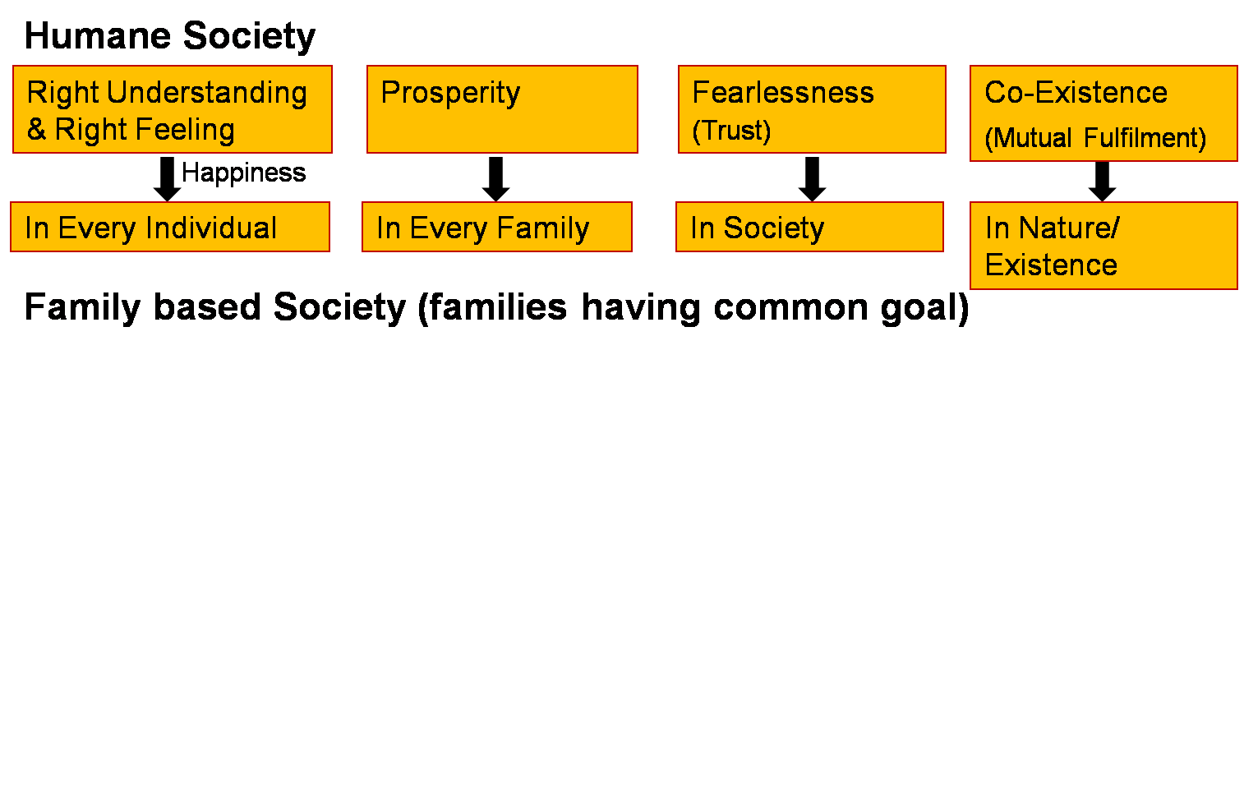
Desired State
People living with human consciousness give rise to a humane society

Slide 129

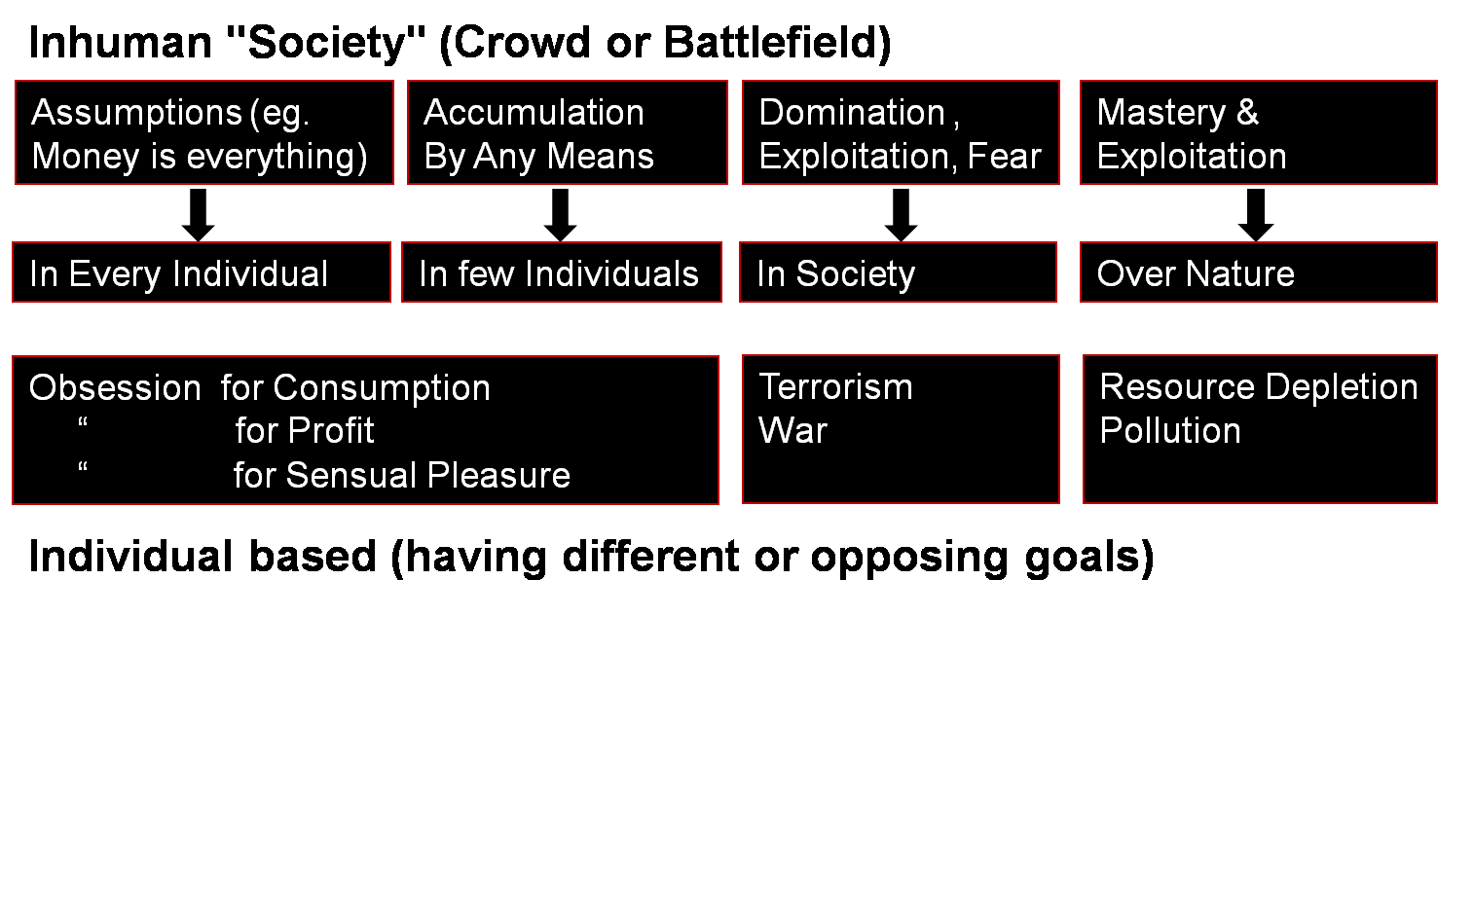
Current State
People living with animal consciousness give rise to inhuman society

Slide 130
Purpose of Education: To Enable Transformation
People living with human consciousness give rise to a humane society
We are making effort for this transformation
We want our institution to be a living example…
Transformation& Progress
laØe.k&fodkl

Slide 131
Did you draw attention to basic realities to be und. to address the aspiration or concern?
8, 9, 10 and 11 | Relationships | Home sickness, gratitude towards parents, teachers and others Ragging and interaction Competition and cooperation Peer pressure | Harmony in the Family (feelings of trust, respect… gratitude, glory, love)
12 | Society | Participation in society | Harmony in the society
13 | Natural Environment | Participation in nature | Harmony in nature/existence
14 | Sum Up | Review role of education Need for a holistic, humane world-vision | Information about UHV-II course, mentor and buddy
15 | Self-evaluation and Closure | Sharing and feedback

Slide 132
UHV-I Session 15 Self-Evaluation and Closure Session
Document prepared by AICTE NCC-IP Sub-committee for Mentor Manual and related Materials for UHV-I
Suggestions for improvement are welcome
All Rights Reserved

Slide 133
Thanks!
This UHV orientation was a glimpse of the introductory UHV content
It was a joy for us to share it with you
We trust the orientation was useful for you, for looking at life in its entirety, developing a holistic, humane world-vision
The full introductory content of UHV is shared in
UHV-II, the mandatory one-semester course
For in-depth study
Open electives are proposed in subsequent years

Slide 134


Purpose of Education: To Enable Transformation
People living with human consciousness give rise to a humane society
Transformation& Progress
laØe.k&fodkl
We are making effort for this transformation
We want our institution to be a living example…

Slide 135
Resources for Preparing

Slide 136
UHV-I Materials for your Preparation
Materials
Presentations (includes interaction questions, videos, assignments…)
Handouts
Surveys and Assignments
Recordings
Material and recordings on “Preparing to Share”
Reference Text Book and Teachers Manual
Further Activities
Higher Level FDPs
Volunteering
Weekly RP Development Meetings
Weekly Mentor-Mentee Meetings
The Morning Session

Slide 137
UHV-I Materials
Links
AICTE FDP-SI Website https://fdp-si.aicte-india.org/
SIP YouTube Channel https://www.youtube.com/@aicte-sip1598
UHV Website https://www.uhv.org.in/
UHV Youtube Channel https://www.youtube.com/@UniversalHumanValues
Presentations, Surveys and Assignments
https://drive.google.com/drive/folders/1016XJBOvMgE1DqLW2pBsb2r6Izbtqzmu?usp=sharing
Preparing to Share Values
https://www.youtube.com/watch?v=vbvPkZ8X4d8&list=PLWDeKF97v9SOkLsFSULd2l6tQ4PRxyvRo
Hindi Recording
https://www.youtube.com/watch?v=nBdLaFUlO8E&list=PLYwzG2fd7hzeSdsr3W9-8B6mFlx-FIsgB
English Recording
https://www.youtube.com/watch?v=OgdNx0X923I&list=PLYwzG2fd7hzer-n_sVjmtFnuSs_Mph4Bi

Slide 138
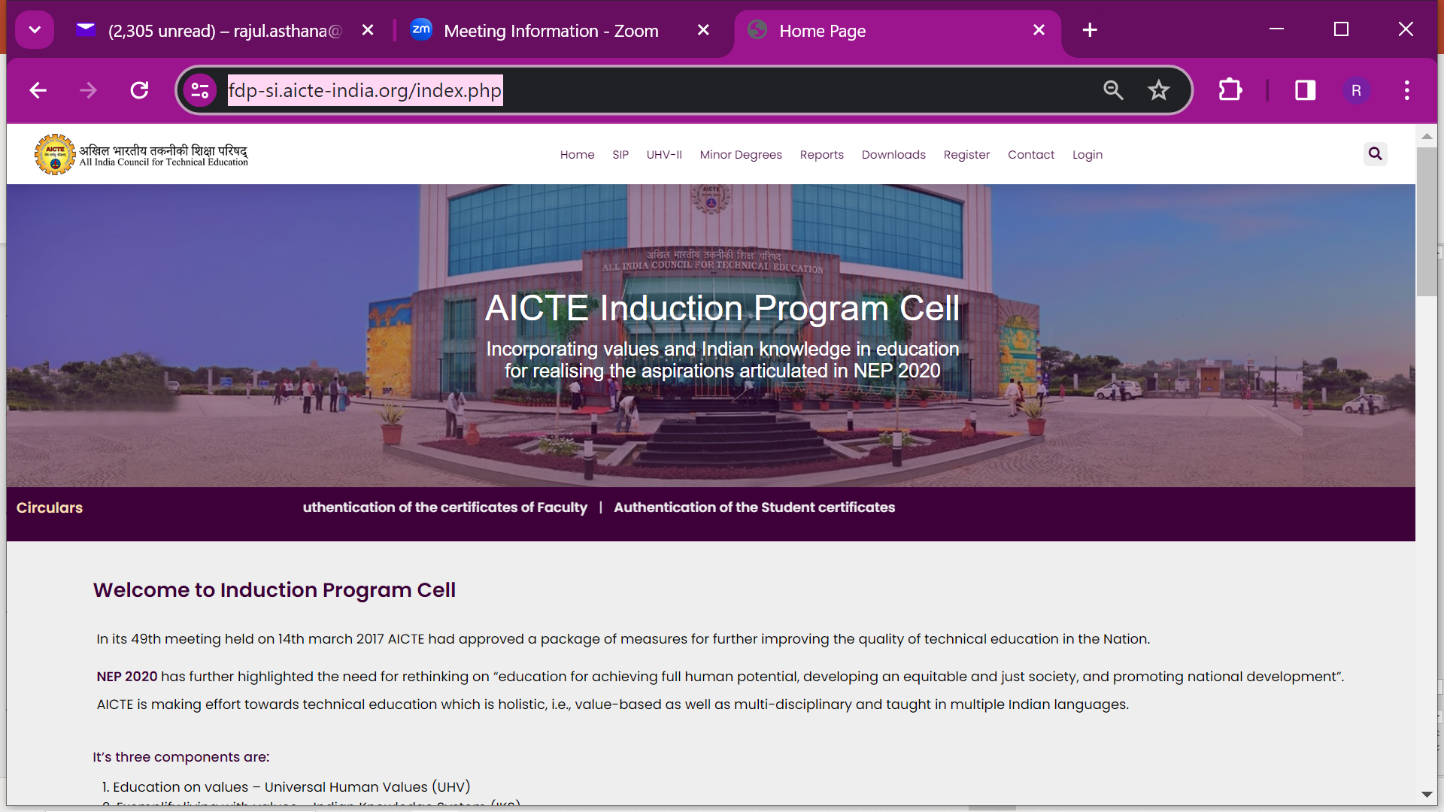
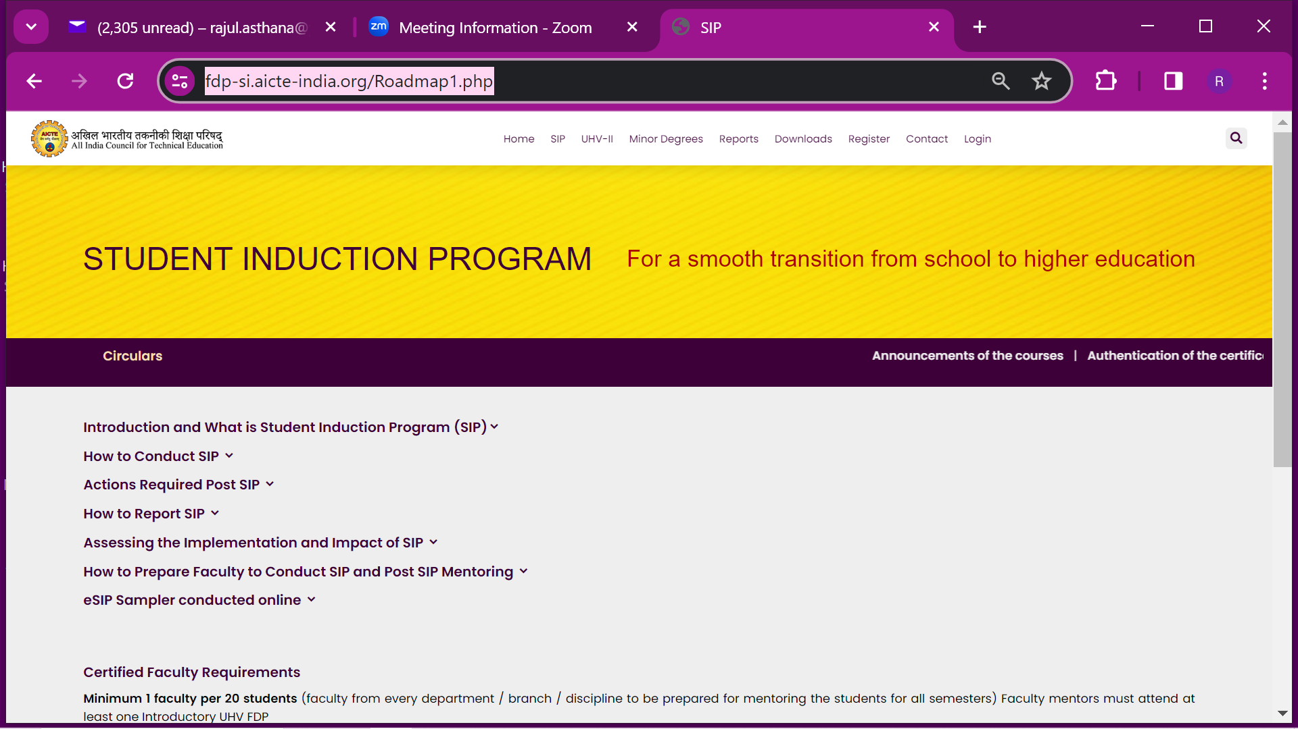
Present AICTE FDP-SI Website
https://fdp-si.aicte-india.org/index.php

Slide 139
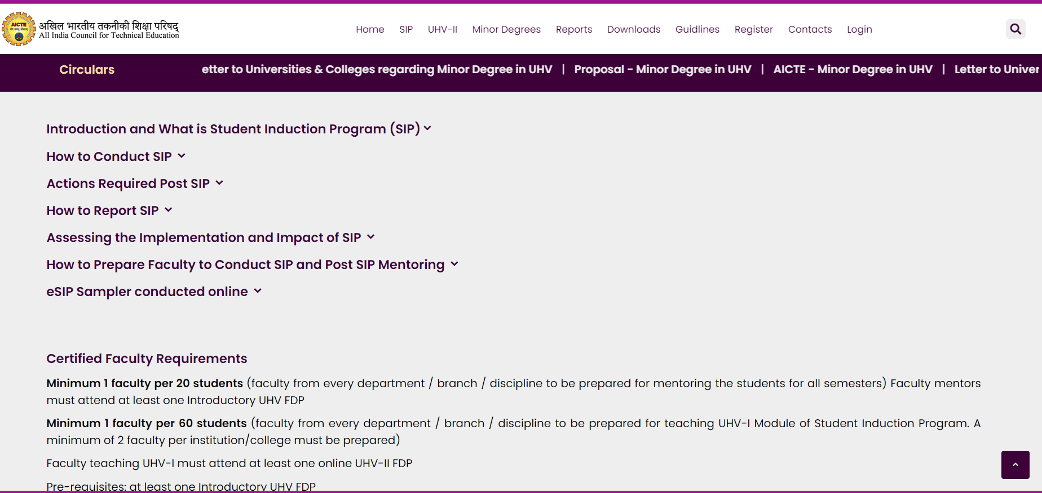
New AICTE FDP-SI Website (under Development)

Slide 140
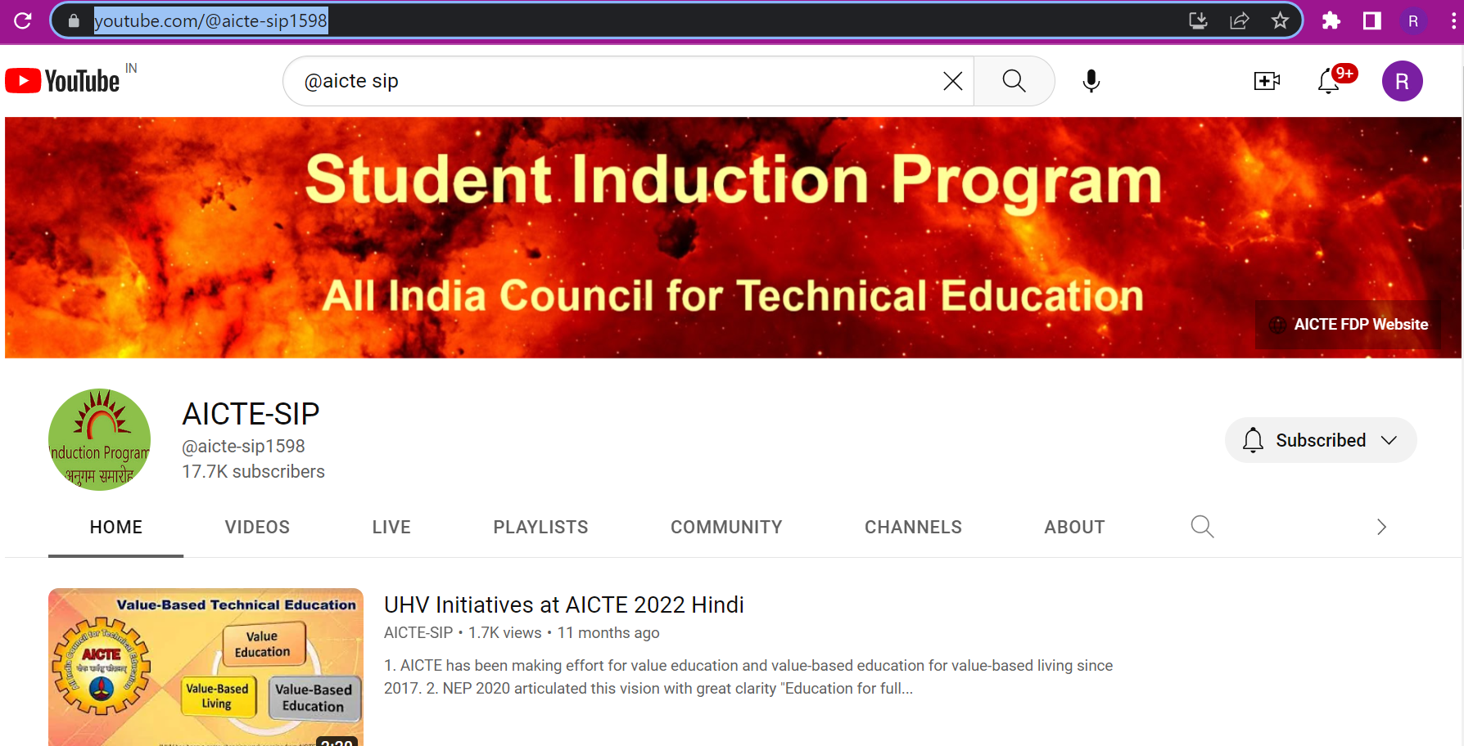
SIP YouTube Channel

Slide 141

UHV Website

Slide 142
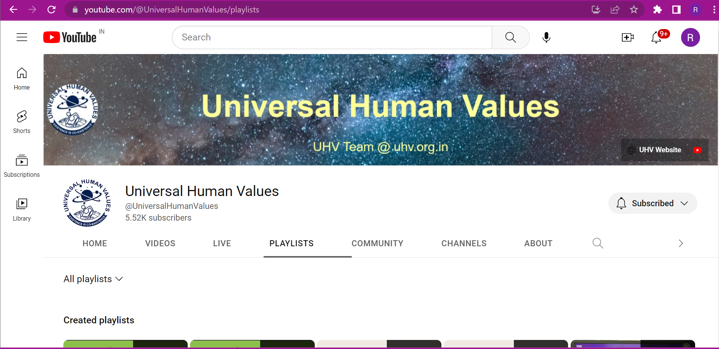
UHV YouTube Channel

